Slide 1
Report for BFX – AT 100
Power Jack Discoloration Issue
Prepared By: QA: Rachel Ruan
Reviewed By: QA leader: Toney HB
Factory leader: David Yin
Date: Aug-08-2023

Slide 2
D1
Establish the Team
Team Leader
Team Member
  QA leader: Toney HB
  Operation leader: David Yin
PM: An Tran, Ben Zheng
QA: Rachel Ruan
SQE: Mr Ha, Antony
IE: Hai Ly
PD: Wen Yong
Notes:
MA5800-X7#display cable modem <MAC> detail

Slide 3
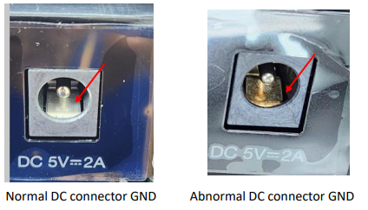
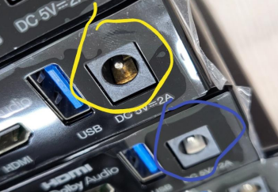
D2
Description the Problem
Issue Description (5W2H)
When | Jul-21-2023
Who | ALT Customer
Where | SK networks warehouse ALT Visual inspection Station
What | DC connector of BFX- AT100 Model was discoloration issue
Why | The GND metal of DC changed from silver to gold color
How | Inspection after cleaning Result PASS
How many | NG Defect : 12/26000 = 0.046%
OK
NG

Slide 4
D3
Containment Action
Check inventory and sorting
1. Fii implement hold and sorting 3550 PCBAs at PTH .
Owner: PD/ Wenyong, Done on Jul-21
2. Fii perform 100% sorting for T99X171.00 in stock.
Owner: PD/ Wenyong, Done on Jul-24
Model | Sorting Q’ty Requirement | Aready sorting Q’ty | Fail Q’ty | Fail Rate
T99X171T00 | 3550 | 3547 | 3 | 0.086%
T99X171.00 | 13440 | 13440 | 0 | 0.0%
Total | 16990 | 16987 | 3 | 0.018%
3. Fii hold and sorting 15k raw material at warehouse , No found same issue.
Owner: SQE/ Peter, Done on Jul-22
Notes:
5.26891E-07 4.96855E-07

Slide 5
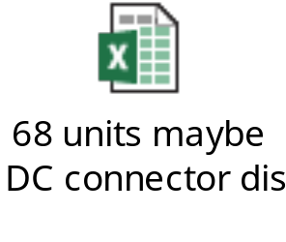
D3
Containment Action
Check SFIS data
Base on NG serial numbers provided by customer, Fii re-checked SFIS data and found out production time at PTH of these units focus in Jan-2023.
Therefore, Fii re-checked SFIS data of 26k - shipment lot in Jun-2023 and found total 68 units (include 12pcs was detected by customer side) also have production time at PTH before Jan-2023.
STT | MAC ID | SHIPPING SN | T Level SN | PTH Station Time
1 | BCF4D4F9A4F8 | 2149688001202301187972 | YXY2OQO | 2023-01-26 16:33:20
2 | BCF4D4F980B8 | 2149688001202301187973 | YXY2JRO | 2023-01-27 08:50:09
3 | BCF4D4F98263 | 2149688001202301187974 | YXS0MH0 | 2022-12-03 01:38:49
4 | BCF4D4F9750A | 2149688001202301187975 | YY21A2R | 2023-02-13 04:06:37
5 | BCF4D4F9ABA4 | 2149688001202301187977 | YY216UE | 2023-02-13 13:31:02
6 | BCF4D4F9A4FB | 2149688001202301187979 | YY21IG0 | 2023-02-17 05:38:22
7 | BCF4D4F9A316 | 2149688001202301187982 | YXY2JGD | 2023-01-28 01:34:56
8 | BCF4D4F9B920 | 2149688001202301187983 | YY21HW4 | 2023-02-17 02:59:40
9 | BCF4D4F98539 | 2149688001202301187984 | YY21GBL | 2023-02-14 04:57:29
10 | BCF4D4F9C75B | 2149688001202301187986 | YY21IEZ | 2023-02-17 15:41:05
11 | BCF4D4F9890D | 2149688001202301187987 | YY709RI | 2023-03-18 08:02:15
12 | BCF4D4F9A4F1 | 2149688001202301187988 | YY21D04 | 2023-02-13 22:47:30
Fii Re-check test data of 68pcs didn’t find any abnormal relate to connection of DC connector.
Summary: As SFIS data, these NG unit focus on PTH production time in Jun-2023, so maybe remaining 56pcs in total 68pcs also has same issue.
Notes:
5.26891E-07 4.96855E-07

Slide 6
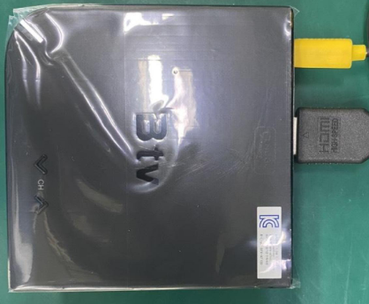

D3
Containment Action
Verify 5pcs (DC connector discoloration) flow chart
A
FT1
FT
RC
Assy
UK
A
Verify
RC1
RC2
Burning
OK
Plug & Un-plug
*10 times
Check bootup
OK Normal
Summary:
Contact resistance OK normal.
DC connector discoloration is VI issue, don’t defect function.
Notes:
MA5800-X7#display cable modem <MAC> detail

Slide 7



D3
Containment Action
1 . SQE sent NG sample ( DC connector discolor) to vendor for analysis.
Owner: SQE/Ha. Done: 2023/Jul/24.
Waiting FA report from vendor . Due date: 2023/Aug/15.
2 . Make quality notice to guide OP must to check DC connector discolor issue.:
Owner: PQE/Rachel. Done : 2023/Jul/21
3. Add OK and NG picture on SOP and re-train OP staffs have to check all connector abnormal ,
discoloration issue .
Owner : IE/Yona. Done : 2023/Jul/22.
Notes:
5.26891E-07 4.96855E-07

Slide 8

D4
Root Cause
Occurrence reason
As vendor FA Analysis conclusion:
1.1 Comprehensive test: the product does not turn yellow immediately after excessive high temperature, and then after contact with vulcanization liquid Produce identical yellowing;
1.2 According to the verification, the product yellows due to the following causes:
(1) There are connections in the storage environment In the case of supplied contact ( air containing sapphires, exposed in the air for a long time ), silver protection The layer is destroyed and yellow oxidation occurs.
② When welding, a large area of contact with flux, welding aid The agent may vulcanize with the silver layer to reflect yellowing.
Notes:
5.26891E-07 4.96855E-07

Slide 9
D4
Root Cause
2. Escape reason
The defect is no effect on the product function, and on SOP/SIP no define check DC connector discoloration issue.
Notes:
5.26891E-07 4.96855E-07

Slide 10
D5
Corrective Action
Suggestions for improvement:
1. Due to the similar characteristics of silver plating, it is more sensitive to sulfide, and the copper column is nickel-plated parts of the same product There is no such phenomenon, in order to completely eliminate this phenomenon, it is recommended to change the shrapnel nickel silver to nickel plating or tin plating specification;
2. Increase the thickness of the coating, which is currently about 30U "and increased to 60U", but this program is not complete Elimination of vulcanization reaction.
Owner: Power-way vendor .
Notes:
5.26891E-07 4.96855E-07

